Slide 1
String builder & String buffer
Java Programming
Anwar Hasan Shuvo
Daffodil International University

Slide 2
Introduction
Before getting into this topic we should learn somethings which are really needed.So we will learn about Heap and Stack.
Concept of Heap and Stack is very important in this topics.
We are going to learn about String, StringBuffer & StringBuilder class.
We are starting our presentation with the concept of Heap and Stack

Slide 3
Heap & Stack
Basically objects are stored in heap and local variables, methods are stored in stack
Heap
Objects
Stack
Local variables
&
Primitive Datatypes

Slide 4
String
String is immutable object . (immutable means once created can not be changed )
The object created as a String is stored in the Constant String Pool.
Every immutable object in Java is thread safe ,that implies String is also thread safe . String can not be used by two threads simultaneously.
String once assigned can not be changed.
String a = " Hello World " ;
// The above object is stored in constant string pool and its value can not be modified
a += “Java Programming" ;
“Java Programming" string is created in constant pool and referenced by the variable named a.
“Hello World" string still exists in string constant pool and its value is not overrided but we lost reference to the “Hello World“ String.

Slide 5
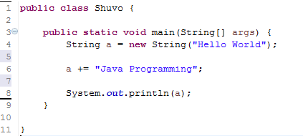
Example with CODE
Heap
Hello World
Heap
Hello World Java Programming
Hello World

Slide 6
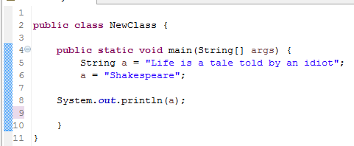
Example with CODE
:String
Life is a tale told by an idiot
It can no longer be accessed
:String
Shakespeare
Life is a tale told by an idiot

Slide 7
String Buffer
StringBuffer is mutable. ( mutable means one can change the value of the object)
The object created through StringBuffer is stored in the heap . StringBuffer has the same methods as the StringBuilder , but each method in StringBuffer is synchronized that is StringBuffer is thread safe .
Due to this it does not allow two threads to simultaneously access the same method . Each method can be accessed by one thread at a time .
But being thread safe has disadvantages too as the performance of the StringBuffer hits due to thread safe property . Thus StringBuilder is faster than the StringBuffer when calling the same methods of each class.
StringBuffer value can be changed , it means it can be assigned to the new value .
String Buffer can be converted to the string by using
toString() method.

Slide 8
Example
StringBuffer s = new StringBuffer("Hello World") ;
// The above object stored in heap and its value can be changed .
s.append(“ Java Programming");
// Above statement is right as it modifies the value which is allowed in the StringBuffer

Slide 9
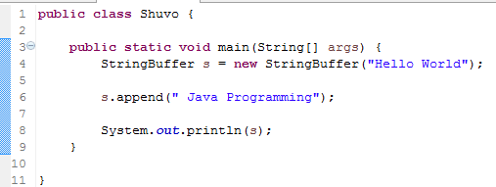
Example with CODE
Heap
Hello World
Heap
Hello World Java Programming

Slide 10
String Builder
StringBuilder is same as the StringBuffer , that is it stores the object in heap and it can also be modified . The main difference between the StringBuffer and StringBuilder is that StringBuilder is also not thread safe.
StringBuilder is fast as it is not thread safe .
StringBuilder object= new StringBuilder("Hello");
// The above object too is stored in the heap and its value can be modified
object=new StringBuilder("Bye");
// Above statement is right as it modifies the value which is allowed in the StringBuilder

Slide 11
Overview
 | String | StringBuffer | StringBuilder
Storage Area | Constant String Pool | Heap | Heap
Thread Safe | Yes | Yes | No
Modifiable | immutable | mutable | mutable

Slide 12
Concatenation Of String
String can be concatenated by using “+” operator or .concat() method.
StringBuffer can be concatenated by using append().
While concatenating StringBuffer is faster than String.
Because
String is converted into StringBuffer and then it use append() method to concatenate.
After that it use toString() method to be converted into String.
StringBuffer uses append() method to concatenate.

Slide 13
Process of Concatenation of String And StringBuffer
String
StringBuffer
append()
toString
String
StringBuffer
append()
toString
String
StringBuffer

